Slide 1
Company Profit Analysis Using Excel
STUDENT NAME : Raghul S
REGISTER NO : 312207320
DEPARTMENT : COMMERCE
COLLEGE : C.KANDASWAMI NAIDU COLLEGE FOR MEN

Slide 2
COMPANY PROFIT ANALYSIS USING MICROSOFT EXCEL

Slide 3
AGENDA
Problem Statement
Project overview
End Users
Our solution
Dataset Description
Modeling Approach
Results and Discussion
Conclusion

Slide 4
PROBLEM STATEMENT :
To analyse the salary manufacture production sale income and profit of a company. To find the profit trend analyse revenue and cost department performance seasonality and external factors using microsoft excel’s pie chart, flow chart, bar diagram and pivot table.

Slide 5
PROJECT OVERVIEW:
Our project aims to analyse the overall sale and profit of a company.
We seek accurately the turnover of the company.
The excel will expose the overall performance of the company.

Slide 6
WHO ARE THE END USERS?
Company management
Share holders
Financial regulatory authority
Public offerors

Slide 7
OUR SOLUTION AND ITS VALUE PROPOSITION:
We propose the full detail of the company’s sales financial position and profit using the data set given to us.
The proposed excel exhibits all the details required to go through all the financial details required to know the company.
Our solution expels the monetary value of the company.

Slide 8
DATASET DESCRIPTION
Revenue: Total income from sales or services
Data/Period: The time frame for the data (e.g., month, quarter, year)
Cost of goods sold (COGS): Direct costs of producing goods or services
Gross profit: Revenue minus COGS
Operating expenses: Costs for running the business, such as salaries, rent, and utilities
Net profit: Gross profit minus Operating expenses, representing the company’s overall profitability
Profit Margin: Net profit as a percentage of revenue, indicating profitability efficiency

Slide 9
THE “WOW” IN OUR SOLUTION:
Yearly profit checklist .
High accuracy in going through the financial statement.
Scalability in the development of the company.

Slide 10
MODELING
Profit Trend Analysis:
Identify the overall profit trend over the last five years. Determine if profits have increased, decreased, or remained stable.
Revenue and Cost Correlation:
Analyze the relationship between revenue and costs to identify key drivers of profitability. Determine whether changes in costs (fixed, variable) or revenue are more strongly associated with profit fluctuations.

Slide 11
Segment/Department Performance:
Break down profits by different segments or departments (e.g., product lines, geographical regions).Identify which segments contribute most to overall profit and which ones may be underperforming
Seasonality and External Factors:
Investigate any seasonal trends in profits and whether external factors (e.g., economic conditions, market trends) have impacted profitability

Slide 12
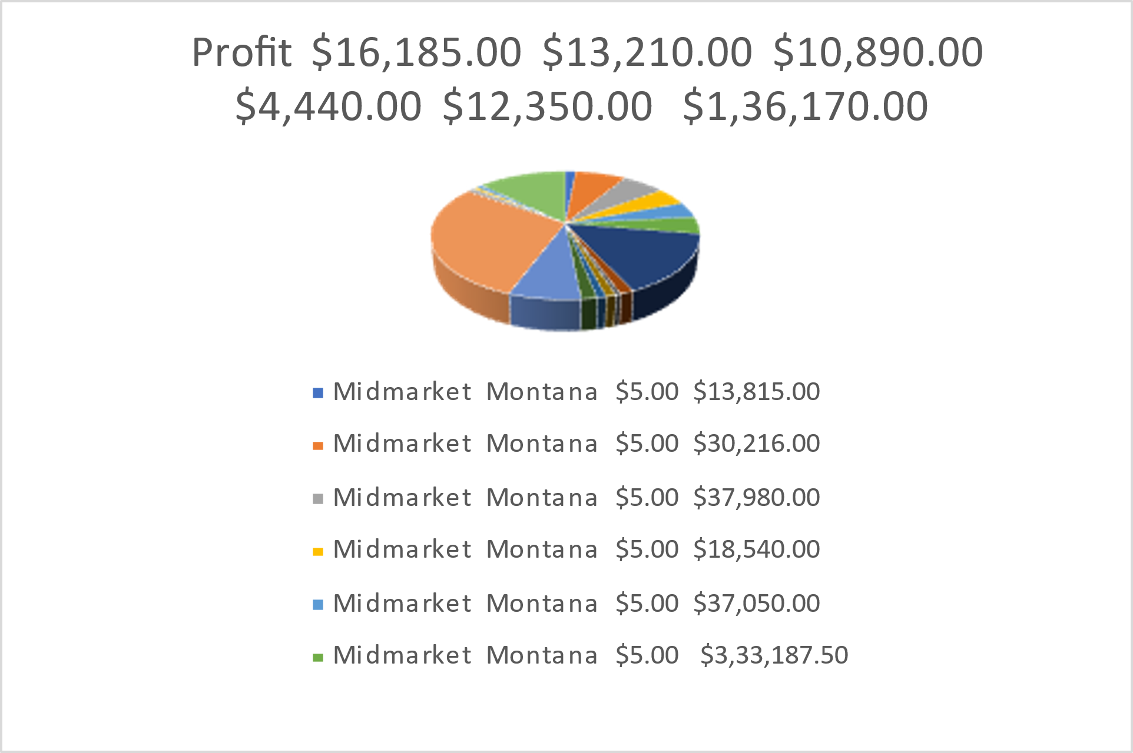
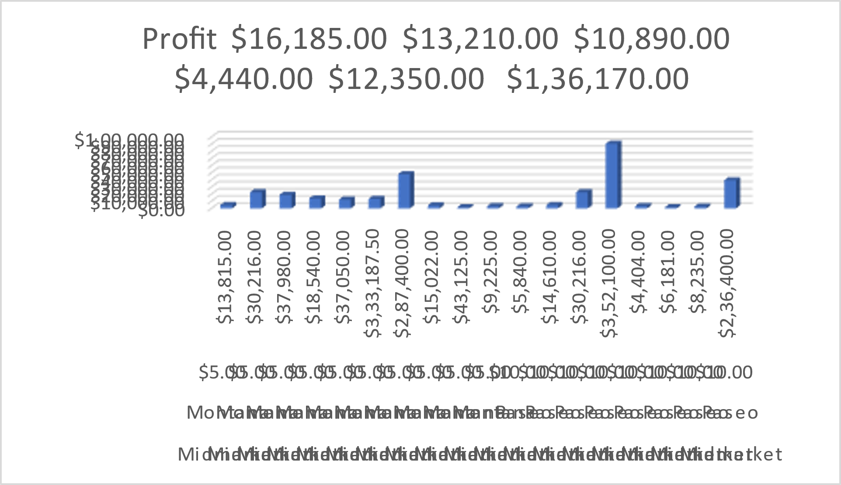
RESULT:

Slide 13
Conclusion:
The above project comprises of the full detailed analysis of a company’s Sales and profits
Anyone can use this project idea to analyse the profits of the companies

